Slide 1
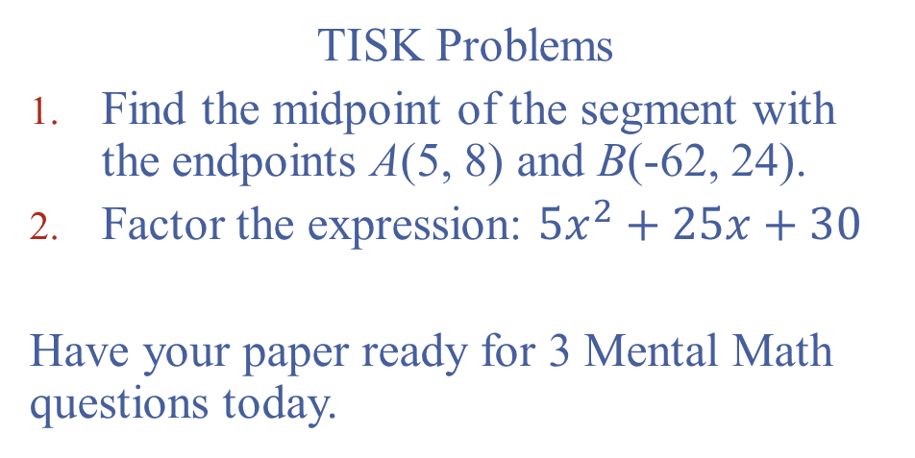
Tuesday, August 7, 2012
TISK Problems
Find the midpoint of the segment with the endpoints A(5, 8) and B(-62, 24).
Factor the expression: $5x^{2}+25x+30$
Have your paper ready for 3 Mental Math questions today.

Slide 2
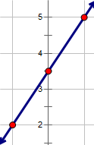
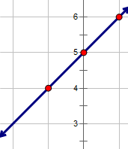
Homework Check
26) (-5, 4)
28) (3, 0)
30) (0, -2)
32) Sample Answer:
(-1, 4), (0, 5), (1, 6)
(-1, 5)
34) Sample Answer:
(-1, 2), (0, 3.5), (1, 5)
(-1, 4)
(36 & 37 on next slide)

Slide 3
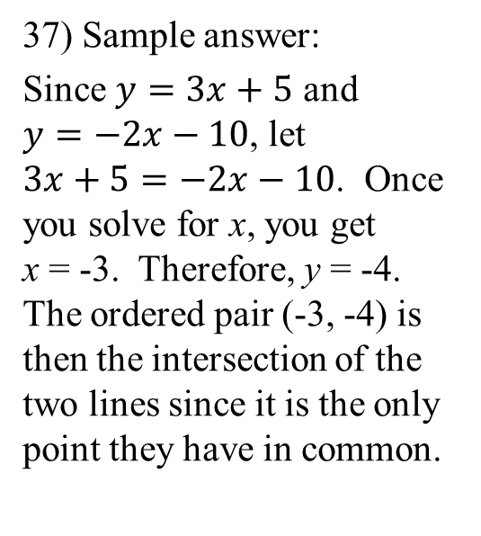
Homework Check
36) Sample answer:
Draw a pentagon and use its sides as intersecting lines. The vertices would form a set of 5 points that are noncollinear.
37) Sample answer:
Since $y=3x+5$ and $y=−2x−10$, let $3x+5=−2x−10$. Once you solve for x, you get
x = -3. Therefore, y = -4. The ordered pair (-3, -4) is then the intersection of the two lines since it is the only point they have in common.

Slide 4
Today’s Lesson Goals
Identify points, lines, and planes.
Learn to name points, lines, and planes using the proper notation.
Define coplanar.

Slide 5
Points, Lines, and Planes
Define
  Point
  Line
  Plane
  Space
Kind of difficult?

Slide 6
Let’s take a look at the way points and lines intersect in space…

Slide 7

Notation, notation, notation!
There are a few proper ways to name a line.
This line is called line RS.
We can write this line using the notation:
$\overset{↔}{RS}$ or $\overset{↔}{SR}$
S
R
Why do you think the order of the letters doesn’t matter?

Slide 8
Notation, notation, notation!
Here is a representation of plane M:
If we add points to the plane, we must add at least three to give it a different name.
Now we can call this plane ABC, BCD, CDA, etc.
Do you think the order of the letters matters when you name a plane?
C
A
B
D
M

Slide 9
Coplanar
What does it mean to be “coplanar”?

Slide 10
Homework
p. 17 #52-55 & 57

